Slide 1
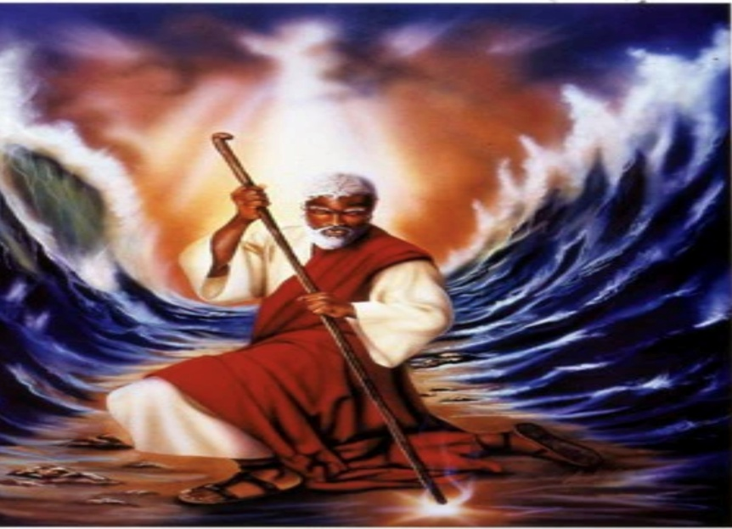
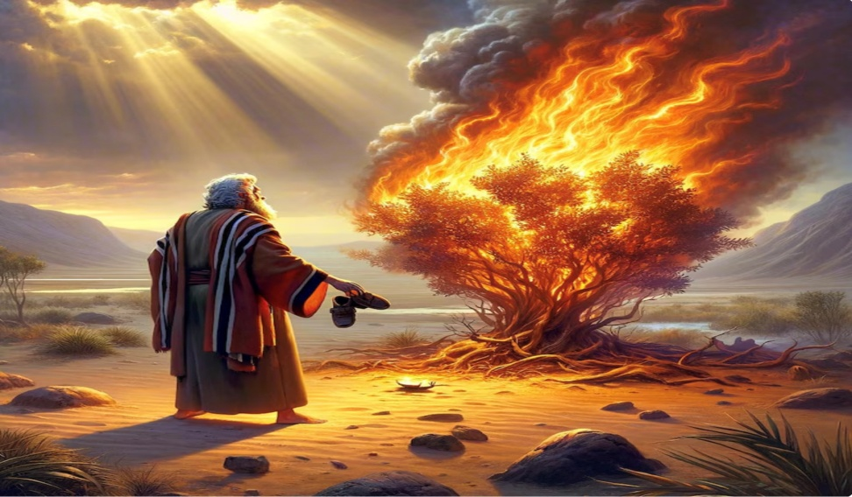

Slide 2
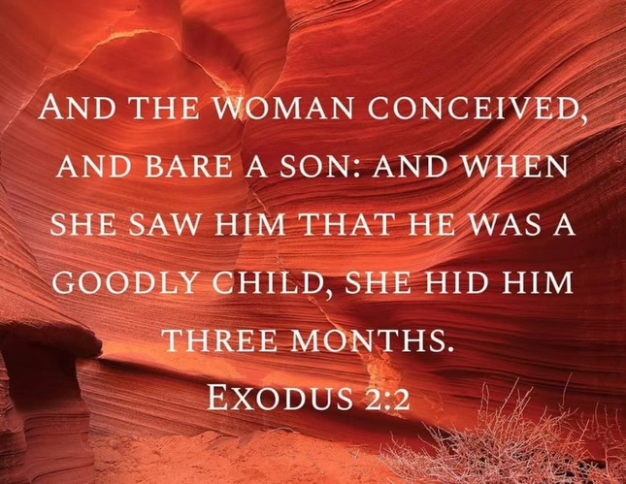
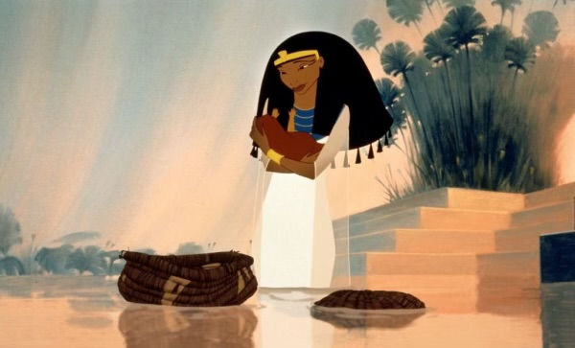
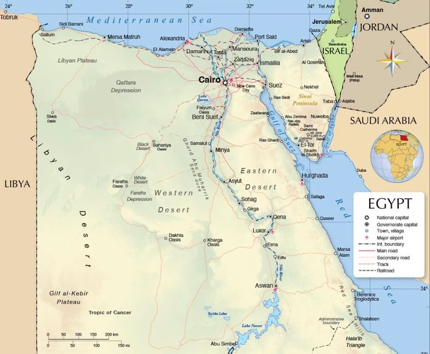
Who is Moses??

Slide 3
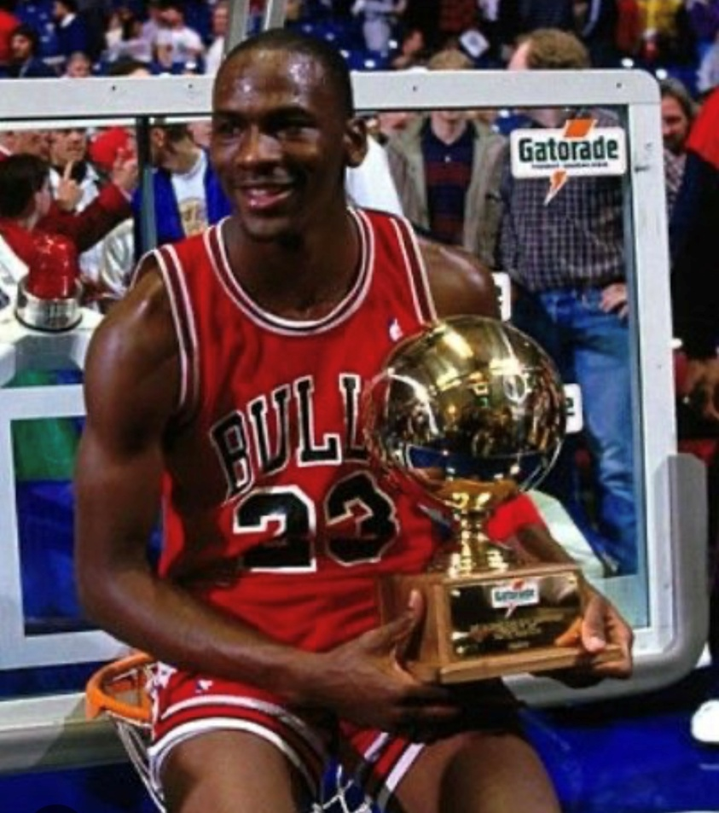
Hall of Fame Qualifications:
3 Straight World Championships
Olympic Gold Medal.
Finals MVP.
All Star Game Competitor.

Slide 4
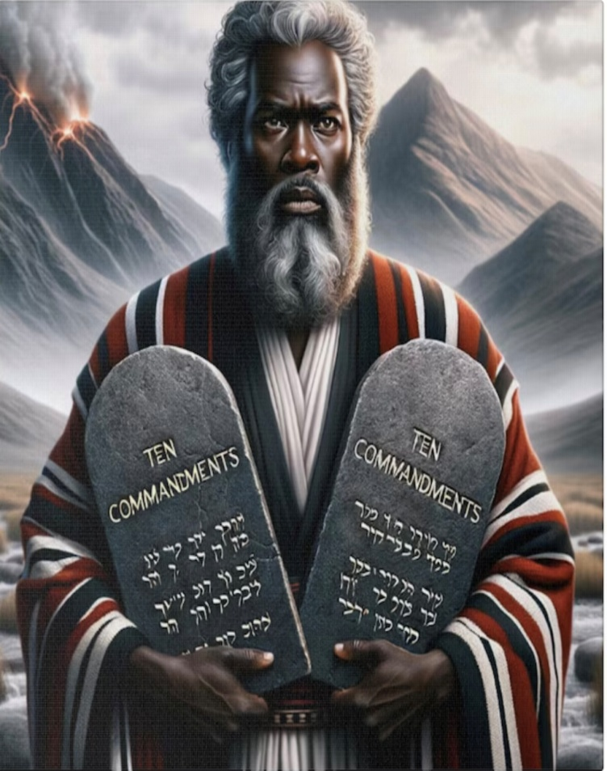
Hall of Fame Qualifications:
Moses Answered God’s Call (Ex.3:4)
Humble Demeanor (Ex.3:11)
Obedient Spirit (Ex.4:2-4)
Human Fear (Ex.4:10-17)

Slide 5
Moses’ Choice

Slide 6
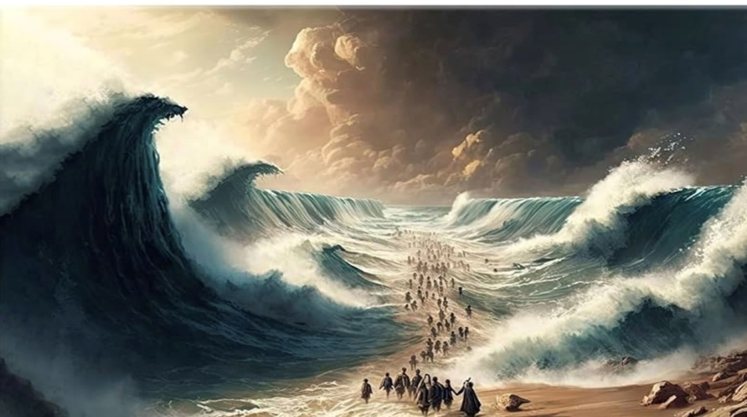
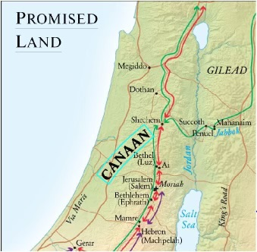
God’s Response

Slide 7
Faith Hall of Fame Application Quiz 2024:
Will you answer God’s call?
Can you look beyond your fears to obey Him?
Do you have faith that God will keep His promises to you?
Can God trust you with His assignment?

Slide 8
