Slide 1
The Faith Hall of Fame

Slide 2
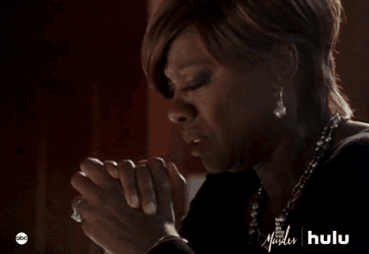
Samuels Story
Born of Faith (1 Samuel 1: 10-11 & 20-22)
In her deep anguish Hannah prayed to the LORD, weeping bitterly. And she made a vow, saying. “Lord Almighty, if you will only look on your servant's misery and remember me, and not forget your servant but give her a son, then I will give him to the LORD for all the days of his life, and no razor will ever be used on his head.”
So in the course of time Hannah became pregnant and gave birth to a son. She named him Samuel, saying, “Because I asked the LORD for him.” When her husband Elkanah went up with all his family to offer the annual sacrifice to the LORD and to fulfill his vow, Hannah did not go. She said to her husband, “After the boy is weaned, I will take him and present him before the Lord, and he will live there always.”

Slide 3
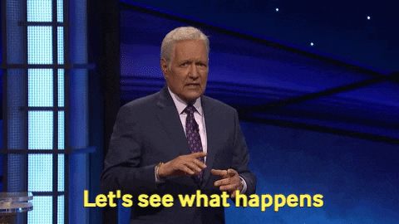

Slide 4
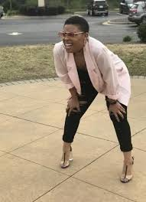
Why is Samuel in the Faith Hall of Fame?
A judge (1 Samuel 7: 3-15)
A “seer” / prophet (1 Samuel 9:18-19)
A King maker Anointed Saul King (1 Samuel 10: 1) Anointed David king (1 Samuel 16: 1-13)

Slide 5
He was a “Seer”: In today’s terms he was a Prophet. I Samuel 9:15-18
¹⁵ Now the Lord had told Samuel the previous day, ¹⁶ “About this time tomorrow I will send you a man from the land of Benjamin. Anoint him to be the leader of my people, Israel. He will rescue them from the Philistines, for I have looked down on my people in mercy and have heard their cry.” ¹⁷ When Samuel saw Saul, the Lord said, “That’s the man I told you about! He will rule my people.” ¹⁸ Just then Saul approached Samuel at the gateway and asked, “Can you please tell me where the seer’s house is?”

Slide 6
Anointed David King of Israel (1 Samuel 16:1-13)
10 In the same way all seven of Jesse’s sons were presented to Samuel. But Samuel said to Jesse, “The Lord has not chosen any of these.” 11 Then Samuel asked, “Are these all the sons you have?” “There is still the youngest,” Jesse replied. “But he’s out in the fields watching the sheep and goats.” “Send for him at once,” Samuel said. “We will not sit down to eat until he arrives.” 12 So Jesse sent for him. He was dark and handsome, with beautiful eyes. And the Lord said, “This is the one; anoint him.” 13 So as David stood there among his brothers, Samuel took the flask of olive oil he had brought and anointed David with the oil. And the Spirit of the Lord came powerfully upon David from that day on. Then Samuel returned to Ramah.

Slide 7
What do these stories teach us about Samuel’s faith and our own?
He had an ear to hear (1 Samuel 9:15) (1 Samuel 3: 8-10)
Obedient to God’s word (Proverbs 1:33)
A Good Servant to the Lord (1 Peter 4:11) (Proverbs 3: 1-4)
Responsive to the Lord (1 Samuel16: 3-4)
An abiding / audacious Faith

Slide 8
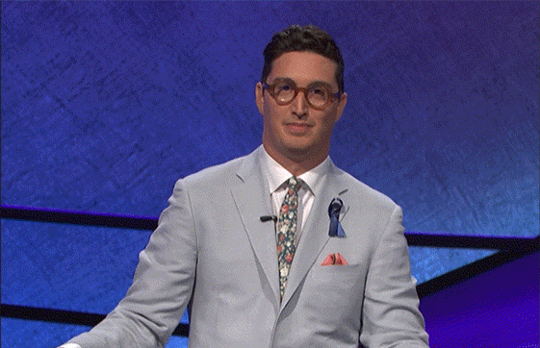

Slide 9
The Challenge of Faith…
What are some everyday challenges that test your faith?
Disappointments of life (home, career, school)
Lacking consistency with trusting the Lord and walking by faith.
Making our own plans without going to the Lord in prayer.
Turning away from God in our darkest times.
How Should We Respond?
Living out the day-to-day action of “Letting go and letting God” (1 Peter 5:7) (Psalms 34: 1-3)
Remember that God provides our needs. His timing is perfect. (Mark 11:24) (Psalms 37:7)
Remembering that God knows what we need and what He has in store for us (Jeremiah 29: 11-14)
Leaning toward God during those dark times (2 Corinthians 4: 8-9)

Slide 10
How does God Respond to Our Challenges in Faith?
1 Corinthians 10:13
Ephesians 2: 8-10
John 11: 25-26
John 15: 4-5
Philippians 4: 6-7

Slide 11
Focus And Intentionally Trust Him

